Slide 1

Department of BES-II
BASIC ELECTRICAL & ELCTRONIC CIRCUITS (BEEC)
COURSE CODE : 23EC1203
Topic:
Maximum power transfer and superposition theorems &
numerical Examples
Session – No.5

Slide 2



AIM OF THE SESSION
To familiarize students with the concept of Maximum Power Transfer and Super Position Theorems and analyzing electrical circuits using these theorems.
INSTRUCTIONAL OBJECTIVES
This Session is designed to:
Describe the steps in Maximum Power Transfer Theorem and Demonstrate to solve some Numerical examples.
Describe the steps in Super Position Theorem and Demonstrate to solve some Numerical examples.
LEARNING OUTCOMES
At the end of this session, you should be able to:
Solve electric circuits by applying the Maximum Power Transfer Theorem
Solve electric circuits by applying the Super Position Theorem

Slide 3
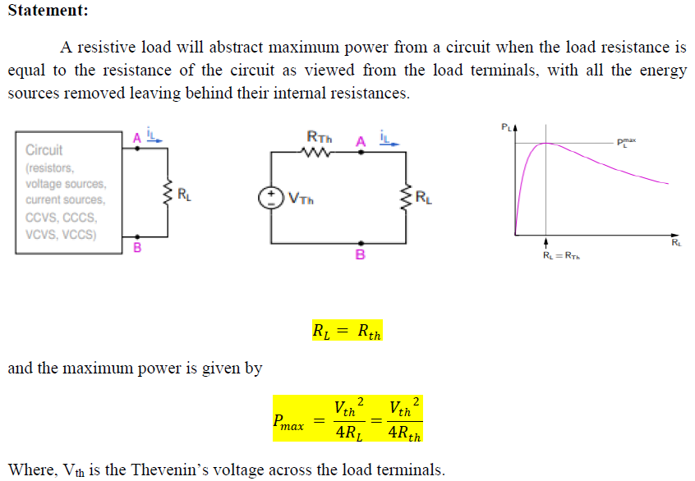
Maximum Power Transfer Theorem

Slide 4

Procedure for Maximum Power Transfer Theorem
1. Remove the load resistance RL
2. Find the Thevenin’s equivalent circuit across the open circuited load terminals
3. According to maximum power transfer theorem, RL = Rth
4. The maximum power is given by

Slide 5
Problems on Maximum Power Transfer Theorem
1. Find the value of the adjustable resistor R which results in maximum power transfer across the terminals a-b of the circuit shown in Fig.1. Also, compute the value of maximum power across the terminals a-b.
Fig. 1

Slide 6
Problems on Maximum Power Transfer Theorem
2. For the circuit shown in Fig.2, determine the value of R_{L} to get the maximum power. Also find the maximum power transferred to the load.
Fig. 2

Slide 7
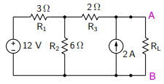
Problems on Maximum Power Transfer Theorem
3. Find RL for which PL is maximum in the circuit shown in Fig.3 using maximum power transfer theorem.
Fig. 3

Slide 8
Problems on Maximum Power Transfer Theorem
4. Calculate the value of R which will absorb maximum power from the circuit of Fig.4. Also, compute the value of maximum power across the terminals A-B.
Fig. 4

Slide 9
Superposition Theorem
Statement:
In any linear circuit containing multiple independent sources, the current through (or voltage across) any element in the circuit is the algebraic sum of the currents through (or voltages across) that element due to each independent source acting alone while other sources are replaced by their internal resistance, if any.

Slide 10
Procedure for Superposition Theorem
Steps of Applying Superposition Principle:
1. Deactivate all independent sources except one source. If the internal resistance of the sources is neglected then the deactivated voltage source is replaced with a “Short Circuit” (R= 0 Ω) and the deactivated current source is replaced with an open circuit (R = ∞) respectively then find the corresponding (V or I) due to that active source.
2. Repeat step (1) for each of the other independent sources.
3. Find the total contribution (V or I) by adding algebraically all the voltages or currents due to the independent sources.

Slide 11
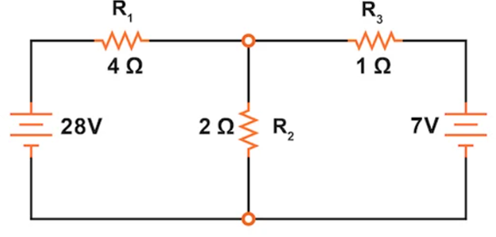
Problems on Superposition Theorem
1. Calculate the current passes through the 2Ω resister using the superposition theorem in the circuit shown in Fig.1.
Fig. 1

Slide 12
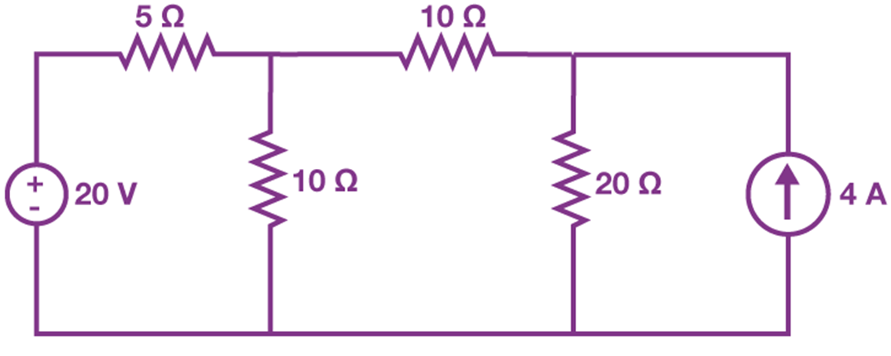
Problems on Superposition Theorem
2. Find the current flowing through 20 Ω using the superposition theorem in the circuit shown in Fig.2.
Fig. 2

Slide 13
LIMITATIONS OF SUPERPOSITION THEOREM
Superposition theorem does not apply to non-linear circuits.
Superposition theorem is only applicable to determine voltages and currents but not power as power dissipation is a nonlinear function.
The application of the superposition theorem requires two or more sources in the circuit.

Slide 14

SELF-ASSESSMENT QUESTIONS
1. The maximum power is delivered from a source to its load when the load resistance is ______ the source resistance.
a) greater than
b) less than
c) equal to
d) less than or equal to
2. If source impedance is complex, then maximum power transfer occurs when the load impedance is _______ the source impedance
a) complex conjugate of
b) negative of
c) equal to
d) negative of complex conjugate of

Slide 15
SELF-ASSESSMENT QUESTIONS
3. What does the superposition theorem state?
The total current in a circuit is equal to the sum of currents through each element.
The total voltage in a circuit is equal to the sum of voltages across each element.
The total response in a linear circuit with multiple independent sources is the algebraic sum of responses caused by each source acting independently.
The total resistance in a circuit is equal to the sum of resistances in each branch.
4. Under what condition is the superposition theorem applicable?
Nonlinear circuits
Circuits with only resistors
Linear circuits with multiple independent sources
Circuits with capacitors and inductors only

Slide 16
SELF-ASSESSMENT QUESTIONS
5. How is the total current in a circuit found using the superposition theorem?
By summing the currents through each resistor
By summing the currents through each element
By algebraically summing the currents caused by each independent source acting alone
By multiplying the currents through each branch

Slide 17
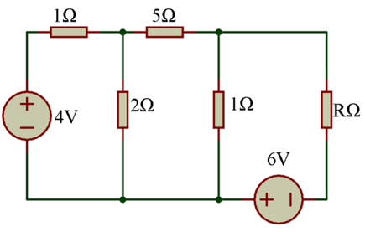
Problems on Maximum Power Transfer Theorem
P1. Find the value of R in the circuit shown in Fig.P1 such that maximum power transfer takes place. What is the amount of this maximum power?
Fig. P1

Slide 18
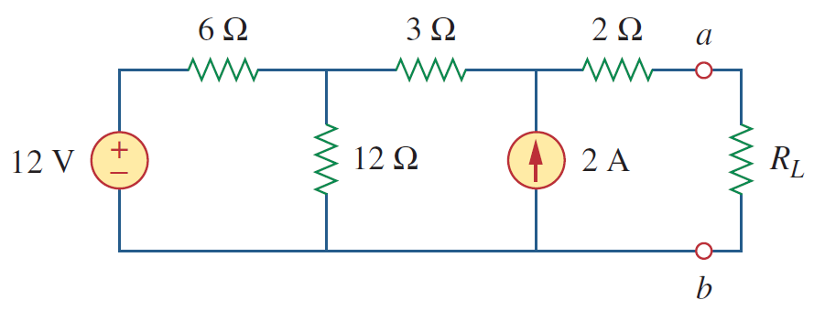
Problems on Maximum Power Transfer Theorem
P2. Find the value of R_{L} in the circuit shown in Fig.P2 for maximum power transfer and also find this maximum power?
Fig. P2

Slide 19
REFERENCES FOR FURTHER LEARNING OF THE SESSION
Reference Books:
1. Circuit Theory - Analysis and Synthesis by Abhijit Chakrabarti
2. Electrical Circuit Theory by B. L. Theraja, M. E. Van Valkenburg
3. Fundamentals of Electric Circuits by Charles K. Alexander, Matthew N.O. Sadiku
4. Engineering Circuit Analysis by William H. Hayt, Jack Kemmerly, Steven M. Durbin
Sites and Web links:
1. https://www.youtube.com/watch?v=6A-Qtst3uZY&list=PLgwJf8NK-2e5s5IUh1wLlTioszBrW58bx
2. https://www.tutorialspoint.com/network_theory/network_theory_mesh_analysis.htm
3. https://en.wikipedia.org/wiki/Mesh_analysis

Slide 20
THANK YOU
Team – BEC

